Slide 1
CS657/790 Cloud Computing
HOP 5 Problems - AWS

Slide 2
HOP 5 Overview - AWS
Goal: Get some practice using the AWS CLI
Work mainly with the resources you already have
Use the Cloud Shell or just a terminal window on a client computer
Three sections
Querying Resources and using JMESPath to format output
Starting and stopping an EC2 instance
Creating an EC2 instance
Create a separate bash script for each section. (All of the resource queries in the first section should be in one script)
Some of the syntax needed is provided in the instructions. For the parts that are omitted, please use an appropriate resource to look up the required syntax

Slide 3
Making a bash Script
You want to be on Linux for this
Put #!/usr/bin/bash on the first line of the script
It is customary to save the file with .sh at the end of the file name
Use chmod +x myscript.sh to mark the script as executable
You can then run the script with ./myscript.sh
You can do simple “logging” using the echo statement if you want to add polish to your output

Slide 4
JMESPath Formatting
To complete this project, you will need to use the JMESPath framework we covered in class and the –output option to format your command output.
Two useful resources for reviewing JMESPath:
https://jmespath.org/tutorial.html
https://jmespath.org/examples.html

Slide 5
Resource Query 1: aws ec2 describe-instances
TODO: Using aws ec2 describe-instances, display a list of all EC2 instances in your account
For each instance, display the following
Name (Hint: it’s in a tag)
Instance ID
Instance Type
Public IP address
Private IP address
State
Name of the 1st security group
Display the output as an array of JSON objects

Slide 6
Resource Query 2: aws s3 ls
Use the aws s3 ls, get a list of buckets in your account, then for one bucket, display a full list of its contents
Run aws s3 ls in your terminal. This will provide a list of bucket names
From the bucket list, choose the Elastic Beanstalk bucket from among your bucket names
For your Elastic Beanstalk bucket, use aws s3 ls to list the contents of the bucket, recursively, with human-readable object sizes, and show the summary at the bottom

Slide 7
Resource Query 3: aws s3api list-buckets
Using the aws s3api command, display a list of buckets in your account
In your display, include only the portion of the command output that contains bucket names and creation dates – exclude any other information that the command returns
Display bucket names and creation dates as a table

Slide 8
Resource Query 4: aws elasticbeanstalk describe-environments
Using aws elasticbeanstalk describe-environments, display a list of your Elastic Beanstalk environments
For each environment, display the following:
Environment name
Solution stack name
CNAME (the public domain name for the environment
Date created
Tier name
Status
Display the output as YAML

Slide 9
Resource Query 5: aws rds describe-db-instances
Using aws rds describe-db-instances, display a list of RDS database servers in your account
For each database server, display the following
Server name (Hint: It’s in a tag)
Instance status
Admin account name
Endpoint address
Allocated storage
Instance create time
Display the output as a list of JSON objects

Slide 10
Starting and Stopping an EC2 Instance
For this problem, we want to write a script that starts an EC2 instance and then stops it, without user intervention.
We also want to display the ID and state of the instance in a consistent way after each step in the process
By default, the AWS CLI commands to start and stop EC2 instances are asynchronous. That is, they start the action but do not wait for completion before returning to the caller. To capture and display instance states, we need to run additional commands to wait for completion.
For the EC2 instance, choose your cloud PC instance. You can obtain its instance ID from the portal.
Before running the script, put your instance into the stopped state

Slide 11
Starting and Stopping an EC2 Instance
The sequence of CLI commands required is as follows:
Show the instance ID and state as tab separated values (describe-instances)
Start the instance, and display the instance ID and state from the command output (start-instances)
Wait for the instance to reach the Running state (wait instance-running)
Show the instance ID and state as tab separated values (describe-instances)
Stop the instance, and display the instance ID and state from the command output (stop-instances)
Wait for the instance to reach the Stopped state (wait instance-stopped)
Show the instance ID and state as tab separated values (describe-instances)

Slide 12
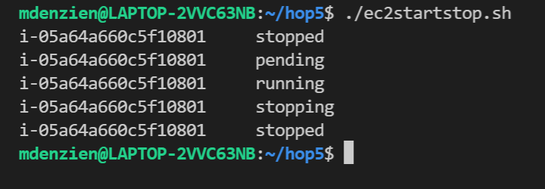
Starting and Stopping an EC2 Instance
Per the above instructions, the above commands will be in a bash script by themselves so you can run it by itself
Please work out the detailed syntax needed to execute the commands and format the output of each command as text values so that the output of the script looks like this:

Slide 13
Creating an EC2 Instance
The aws ec2 run-instances command creates one or more EC2 instances and starts them
For this problem, we want to create one EC2 instance with the following requirements
Use the Ubuntu 20.04 server image
Create a new key pair for just the new instance
Size the VM very small (t2.micro)
Establish public access via SSH (and be able to connect afterwards without modifying the instance in the portal)
Establish a friendly name for the instance, as if we created the instance in the management console
Take the defaults for remaining aspects of the instance, such as storage size, network placement, etc.

Slide 14
Establishing SSH Access
To have SSH access to the new instance, we need to install an SSH key, and also be sure port 22 is open to the public internet.
We will also need to save the private key on the client so that we can connect to the new instance.
Just like the management console, AWS requires that the SSH key pair exist in your account and have a specific name before you can create the instance.
We will create the key pair using the CLI, then refer to it when we create the instance

Slide 15
Creating an SSH Key Pair in the CLI
You can create a key pair using the CLI like this: aws ec2 create-key-pair --key-name hop5-ssh-key
The above creates the pair but doesn’t help much with capturing the private key. Instead, format the command output as text and redirect it to a file: aws ec2 create-key-pair --key-name hop5-ssh-key --output text > hop5-private-key
The hop5-private-key file will contain a usable private key with some extra stuff at the beginning which you can delete, then save the file as a valid private key

Slide 16
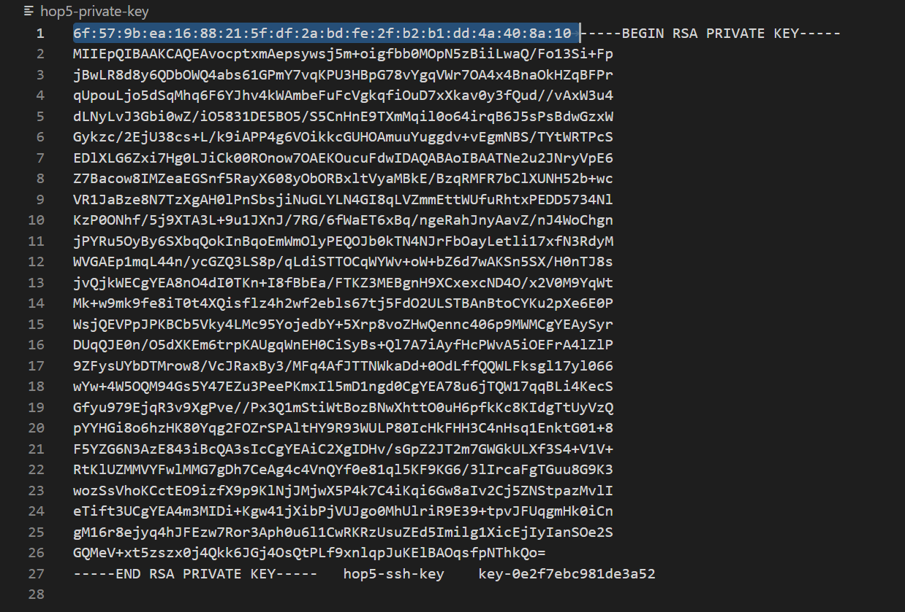
SSH Private Key File
Delete the highlighted stuff, then save the file
Afterwards, you can import the private key into BitVise SSH.

Slide 17
Creating an EC2 Instance
To meet the requirements, we still need to find:
The image ID for an Ubuntu 20.04 server. You can find this in the management console by starting to create an instance, select the Ubuntu 20.04 image, and copy the image ID out of the browser. The image ID I found was ami-0ada6d94f396377f2
A security group we can use for the new instance that will allow public access on port 22. I found one in my account from previous work that I could use. It is shown on the next slide. We could also create a new security group using the CLI, but we are taking a shortcut to keep this simple.
A way to add tags to the new instance using the CLI. We can add a Name tag to the instance by including the following in the command: --tag-specifications "ResourceType=instance,Tags=[{Key=Name,Value=hop5-vm}]"

Slide 18
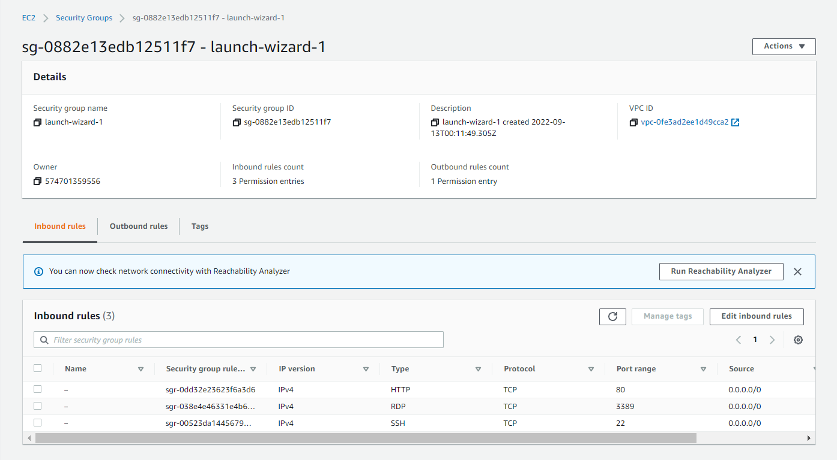

Slide 19
At Long Last, Create the Instance
We can now create an instance that meets the requirements with the following command. Note: In your terminal, the command will be all on one line.
aws ec2 run-instances --image-id ami-0ada6d94f396377f2 --instance-type t2.micro --key-name hop5-ssh-key --security-groups launch-wizard-1 --tag-specifications "ResourceType=instance,Tags=[{Key=Name,Value=hop5-vm}]“
When the above is done, connect to the new instance with BitVise SSH and look around to see that the VM meets the requirements.
For your submission, include the script, the script output, and a screen shot of your SSH connection to the new instance

