Slide 1
CS657/790 Cloud Computing
HOP 5 Problems - Azure

Slide 2
HOP 5 Overview
Goal: Get some practice using the Azure CLI
Work mainly with the resources you already have
Use the Cloud Shell or just a terminal window on a client computer
Three sections
Querying Resources and using JMESPath to format output
Starting and stopping a virtual machine
Creating a virtual machine
Create a separate bash script for each section. (All of the resource queries in the first section should be in one script)
Some of the syntax needed is provided in the instructions. For the parts that are omitted, please use an appropriate resource to look up the required syntax

Slide 3
Making a bash Script
You want to be on Linux for this
Put #!/usr/bin/bash on the first line of the script
It is customary to save the file with .sh at the end of the file name
Use chmod +x myscript.sh to mark the script as executable
You can then run the script with ./myscript.sh
You can do simple “logging” using the echo statement if you want to add polish to your output

Slide 4
JMESPath Formatting
To complete this project, you will need to use the JMESPath framework we covered in class and the –output option to format your command output.
Two useful resources for reviewing JMESPath:
https://jmespath.org/tutorial.html
https://jmespath.org/examples.html

Slide 5
Resource Query 1 az group list
Using the az group list command, display a list of the resource groups in your account
In the output, include only the name and location of each resource group
Format your output as a table with column headings at the top of the table

Slide 6
Resource Query 2 az resource list
Using the az resource list command, display a list of all the resources in your account, across all resource groups
For each resource, include only the name, resource type, resource group name, location, date/time created, and date/time last changed
Display the output as an array of json objects

Slide 7
Resource Query 3 az vm list
Using the az vm list command, display a list of all virtual machines in your account, across all resource groups
For each virtual machine, display the following
VM name
The path to where the SSH public key is stored
VM location
Resource group name
Admin user name
Time of VM creation
VM Size
VM state eg. Running, Stopped (deallocated). Hint: To get this will require the -d or –show-details option on the command
Display the output as an array of JSON objects

Slide 8
Resource Query 4 az webapp list
Using the az webap list command, display a list of App Service webapps within your account
For each webapp, display the following
Webapp name
Resource group name
Current webapp state
Primary hostname
All enabled hostnames
Display the output as an array of JSON objects

Slide 9
Resource Query 5 az mysql flexible-server list
Using the az mysql flexible-server list command, display a list of MySQL database servers within your account
For each database server, display the following
Server name
SKU name
Server state
Amount of storage
Resource type
Resource group name
Location
Display the output as a table with labeled column headings

Slide 10
Starting and Stopping a Virtual Machine
For this problem, we want to write a script that starts a virtual machine and then stops it, without user intervention.
We also want to display the name and state of the instance in a consistent way after each step in the process
Fortunately, the Azure CLI commands to start and stop virtual machines are synchronous by default. That is, they perform the action completely before returning to the caller.
For the virtual machine, choose your cloud PC instance. You can obtain its name from the portal.
Before running the script, put your VM in the Stopped (deallocated) state

Slide 11
Starting and Stopping a Virtual Machine
The sequence of CLI commands required is as follows:
Show the name and state as tab separated values (vm list)
Start the instance (vm start)
Show the name and state as tab separated values (vm list)
Stop and deallocate the instance (vm deallocate)
Show the name and state as tab separated values (vm list)
Hint: To display the VM state will require the -d or –show-details option on the vm list command

Slide 12
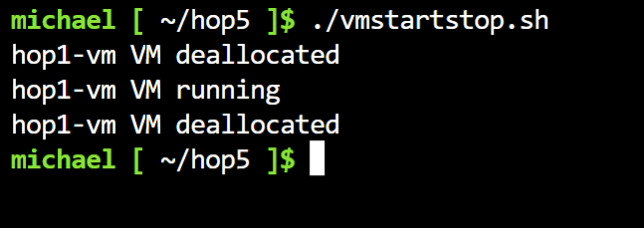
Starting and Stopping a Virtual Machine
Per the above instructions, the above commands will be in a bash script by themselves so you can run it by itself
Please work out the detailed syntax needed to execute the commands and format the output of each command as text values so that the output of the script looks like this:

Slide 13
Creating a Virtual Machine
The az vm create command creates a virtual machine and starts it
For this problem, we want to create a VM with the following requirements
Put the VM in its own resource group so we can delete it and all of its related resources with one command
Use the latest Ubuntu 20.04 server image
Create a new key pair for just the new instance
Make the admin account name ‘ubuntu’
Establish public access via SSH (and be able to connect afterwards without modifying the instance in the portal)
Take the defaults for remaining aspects of the instance, such as VM size, storage size, network placement, etc.

Slide 14
Establishing Public Access
To gain SSH access to the new VM, we need to install an SSH key and make sure the VM has a public IP address with port 22 open to the public internet
We will also need to save the private key on the client so that we can connect to the new VM.
We can achieve the above by including 2 options on the command
--public-ip-sku Standard (gives the VM a public IP. )
--generate-ssh-keys (creates key pair and writes private key to client)
When creating a Linux VM on Azure, port 22 is open by default
The key pair will be written to ~.ssh/id_rsa and ~/.ssh/id_rsa.pub in your home folder. The id_rsa file can be imported to BitVise SSH as-is.

Slide 15
Selecting the Right Image
We want to use the latest Ubuntu 20.04 Server image. We need to know how to specify it.
The –image option on the az vm create command specifies which image to use
But what images are available?

Slide 16
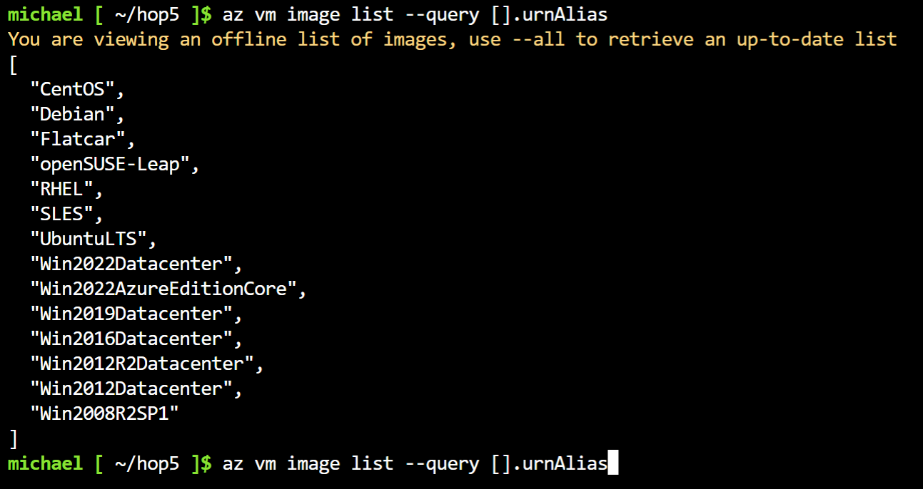
Selecting the Right Image
We can get a simple list of images with az vm image list (and use JMESPath to clarify the output).
UbuntuLTS is an option. But what version is it?
As of this writing, the UbuntuLTS image is 18.04.
We still need to find Ubuntu 20.04.

Slide 17
Selecting the Right Image
We can add –all to the vm image list command, but the resulting list is huge. I pressed Ctrl-C after a few minutes.
We need to filter the list. But how?

Slide 18
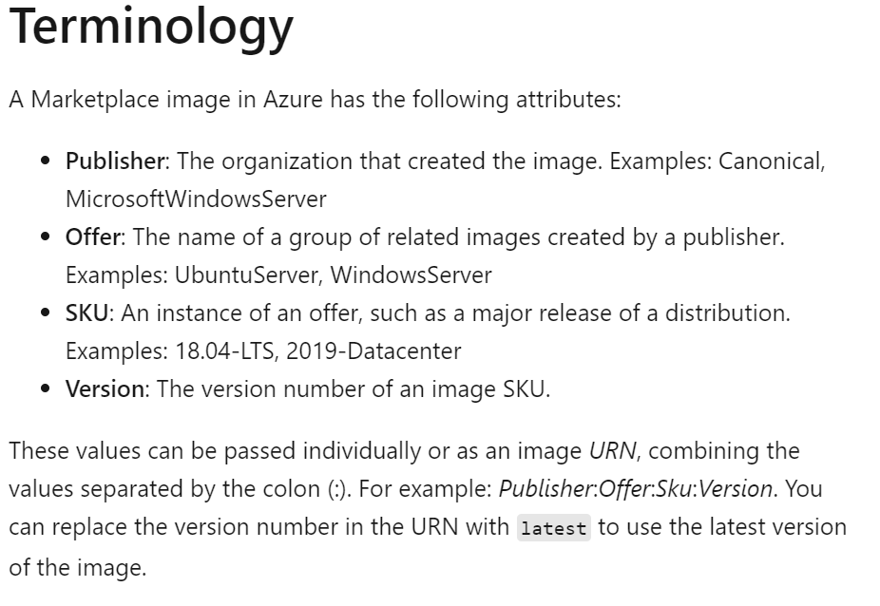
Selecting the Right Image
After a Google search on ‘azure vm image list’, this seemed promising
https://learn.microsoft.com/en-us/azure/virtual-machines/linux/cli-ps-findimage
The above link provided the excerpt at right.
VM images are classified by publisher, offer, SKU and version.
Microsoft suggests that we can filter by publisher. But what publishers exist?

Slide 19
Selecting the Right Image
We can get a list of publishers with az vm image list-publishers
On that command, we need to specify a region az vm image list-publishers –location westus3
The above command returns 1755 publishers in the westus3 region. Not easy to choose one from this list.
Conclusion: We really need to know the publisher of Ubuntu 20.04.
Luckily, we do know, sort of: Its Canonical.
We can continue to use Microsoft’s advice, listing offers by publisher.

Slide 20
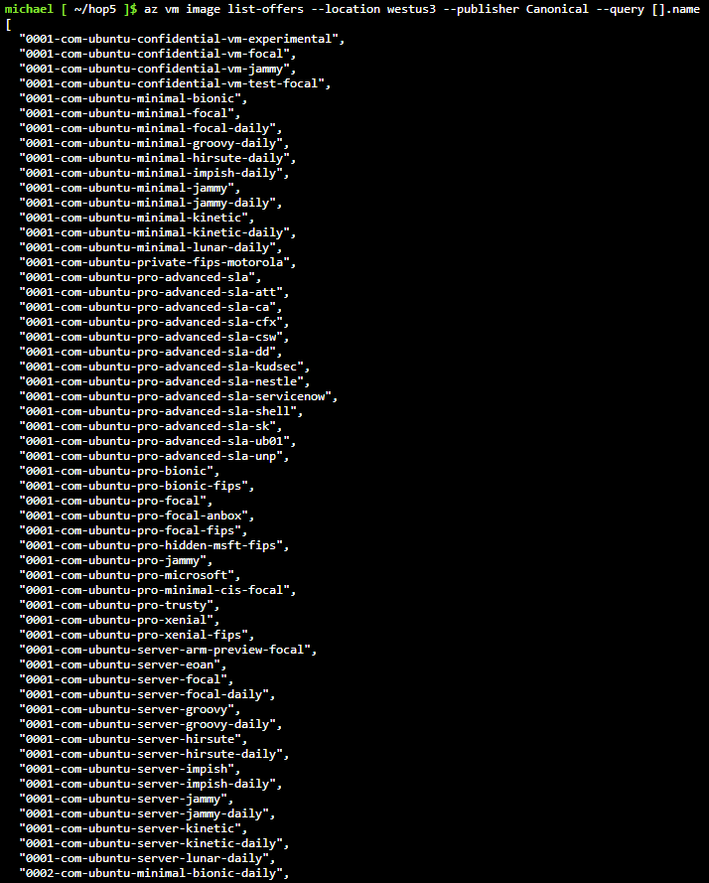
Selecting the Right Image
We list the offers in WestUS3 from Canonical with az vm image list-offers –location westus3 –publisher Canonical and query only the name
There are only a little over 60 offers from Canonical in WestUS3.
We know that the nickname for Ubuntu 20.04 is ‘focal’.
Scanning the list, we see an offer called 0001-com-ubuntu-server-focal.
Now, what about the SKU?

Slide 21
Selecting the Right Image
Amazingly, there are only 3 SKUs for Canonical Ubuntu 20.04 server in WestUS3 – see command below
We will guess that we want the -gen2 SKU (It sounds newer)
Per the article excerpt above, we can specify ‘latest’ to get the latest version
That gives us Canonical:0001-com-ubuntu-server-local:20_04-lts-gen2:latest for the image identifier

Slide 22
Selecting the Right Image
Naturally, there is a shortcut to all of the above.
I already have a virtual machine that has was created from the image we want. I can display it in the portal – see next slide.
But, we won’t always have the advantage of having an existing virtual machine and we’ll need to search through images to find the right one.

Slide 23
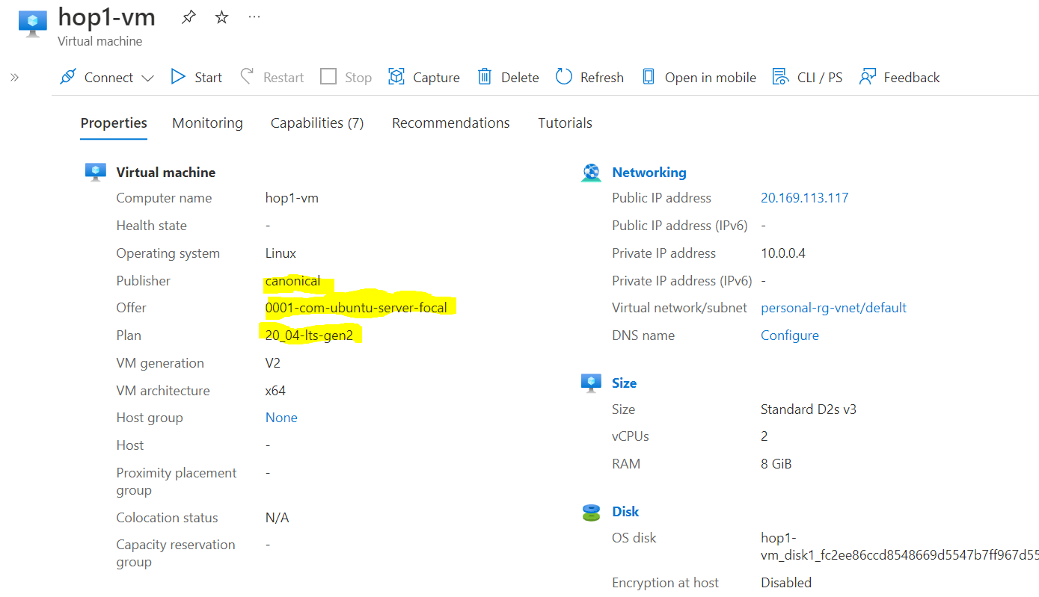

Slide 24
At Long Last, Create the VM
Create the resource group with a command like az group create –name hop5-rg –location westus3
Next, create a virtual machine that meets the requirements with the following command. Note: In your terminal, the command will be all on one line.
az vm create --name hop5-vm --resource-group hop5-rg --image Canonical:0001-com-ubuntu-server-focal:20_04-lts-gen2:latest --public-ip-sku Standard --admin-username ubuntu --generate-ssh-keys
When the above is done, the SSH key pair files will be in ~.ssh/id_rsa and ~/.ssh/id_rsa.pub. Download the private key to your client computer and import into BitVise SSH.
Connect to your VM and look around to be sure the requirements were met
For your submission, include the script, the script output, and a screen shot of your SSH connection to the new VM

