Slide 1
WeatherSnap
A minimally invasive solution to your Weather Needs

Slide 2
Table of contents
01
02
03
04
What is WeatherSnap
How Does It Work
Why we designed our architecture this way
Who is this for

Slide 3
01
What is WeatherSnap

Slide 4
WeatherSnap
WeatherSnap is a minimally invasive SNS solution for Weather Alerts.
It is a proof of concept designed to explore the capabilities of Pub-Sub notifications via AWS SNS
WeatherSnap is Designed to execute twice a day (Once at 7am and Once at 4pm Milwaukee time) and send an email/text alert of the weather to all subscribers on the Sub list of the SNS Queue.

Slide 5
02
How Does It Work?

Slide 6
Components
The components are quite minimal, All you require is:
An API Key to OpenWeatherMap
A Lambda Function that Calls the API Key and gets our required Data
A SQL Database to store our user Information
A SNS Queue
An EC2 Instance for our Registration Repl (Prototype)

Slide 7
User Subscribes to the SNS Queue
Live Data is Sent to the SNS Queue to be published to all Subscribers
Register
SNS Queue
Trigger
Publish
The function triggers calling the OpenWeatherMap API and fetching Live data
All Subscribers on the WeatherSnap Queue are notified via Email/Text

Slide 8
Architecture

Slide 9
03
Why we Designed our architecture this way

Slide 10
We had quite a few options for this Special Interest Project
Why SNS?
We could’ve explored something completely new but we wanted to master what we learned in class before we moved onto newer things.
We adapted project 4 to fit our needs and create a solution to a real world problem while understanding the concept behind the infrastructure

Slide 11
We had quite a few options for this Special Interest Project
Why AWS?
This is quite subjective in our opinion, we could’ve done the same project on Azure, and we tried!
But we simply didn’t like the UI or the resource groups Azure had to offer for our specific project
Lightsail DB and Lambda deployments in Project 4 showed us a clear path of what we wanted to achieve
Our Journey
To Azure
From Aws
Back to AWS!

Slide 12
04
Who is this for?

Slide 13
The Target Audience
Type A | Type B | Type C
Cannot enable Location Services | Not Tech Savvy | Does not have a SmartPhone
Requires minimal Information gathering | Doesn’t Check the Weather App | Does have a 2G Phone with SMS
May not have public telecom access | Doesn’t properly understand the Build In Weather App | Is able to get Telecom Access

Slide 14
Type A
Type A customers would be similar to those in the Military or other Government Institutions where Data Breaches such as location are unacceptable.
You may remember when the US Airforce was compromised in Germany due to the use of an exercise app that tracked the entire outline of all US Airforce Bases in europe which lead to the US Banning all applications that used Location Services on Government Phones
WeatherSnap Could be run on private networks with no access to any external services besides the Weather API.
All of the contact details in the SNS Queue can remain within the control of the organization managing the service.

Slide 15
Type B
Type B customers would be Those customers who struggle slightly with Technology. They may be used to emails and texts but still havent gotten up to speed with applications etc.
Elderly People and Non Tech Savvy people usually use technology for communication and not much else. For them apps such as the weather app are far too complicated to understand and use.
WeatherSnap provides daily updates via concise emails/texts daily which provide ease of use and understanding to these types of customers.

Slide 16
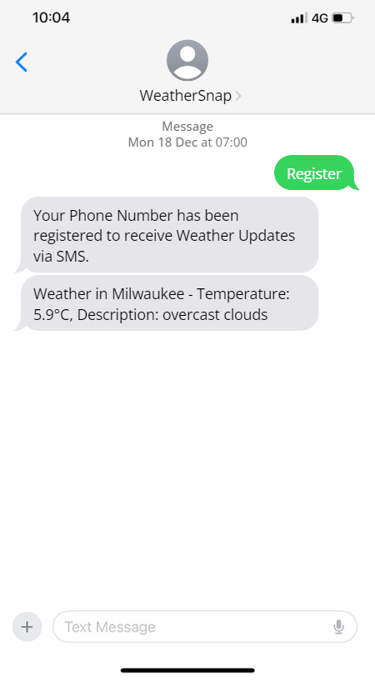
Type C
Type C customers would be Those customers who simply do not have access to the internet or other means of communication besides 2G Telecom.
For example, According to the Pakistan Telecommunication Authority, 50% of Pakistan’s Telecom Traffic is still 2G! Meaning that 50% just uses their phone for texts and calls.
WeatherSnap could (in the Future) allow them to easily register via a text message to register for text based weather updates.

Slide 17
LET’S DEMO!

